Slide 1
Chapter 3

Slide 2
Objectives

Slide 3
Objectives (continued)

Slide 4
The relational operators

Slide 5
The syntax of the global isNaN method

Slide 6
The logical operators in order of precedence

Slide 7
How the logical operators work

Slide 8
Terms

Slide 9
The syntax of the if statement

Slide 10
An if statement with else if and else clauses

Slide 11
An if statement with a compound conditional expression

Slide 12
How to test a Boolean variable

Slide 13
The syntax of a while loop

Slide 14
The syntax of a do-while loop

Slide 15
The syntax of a for loop

Slide 16
A for loop that calculates the future value of an investment

Slide 17
Terms

Slide 18
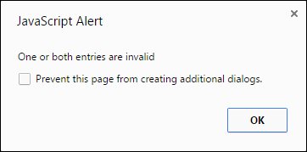
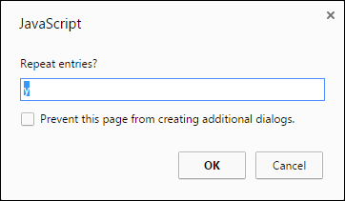
Two of the dialog boxes for the Miles Per Gallon application

Slide 19
The JavaScript for the MPG application

Slide 20
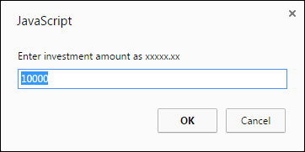
The first of three prompt dialog boxes for the Future Value application

Slide 21
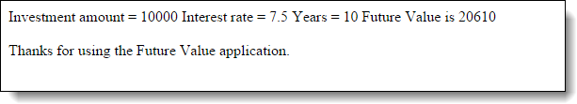
The result in the browser

Slide 22
The HTML and JavaScript for the FV app

Slide 23
The HTML and JavaScript (continued)

Slide 24
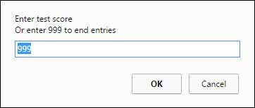
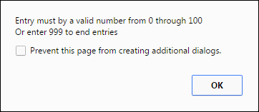
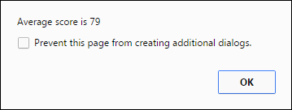
The dialog boxes for the Test Scores app

Slide 25
The JavaScript in the head section of the HTML file

Slide 26
The syntax for creating an array

Slide 27
The syntax for referring to an element of an array

Slide 28
How to add values to an array

Slide 29
The syntax for getting the length property of an array

Slide 30
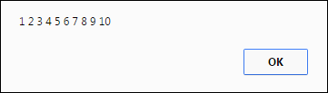
Code that puts the number 1 through 10 into an array

Slide 31
Code that puts four totals in an array

Slide 32
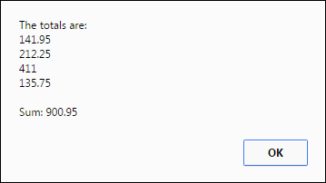
Code that displays the totals and the sums

Slide 33
Terms

Slide 34
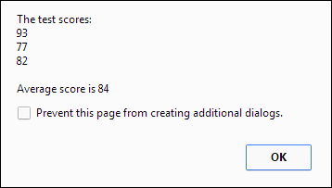
The result of the Test Scores app with an array

Slide 35
The JavaScript for the enhanced app

Slide 36
The JavaScript (continued)

Slide 37
Exercise 3-1 Enhance the Future Value app

Slide 38
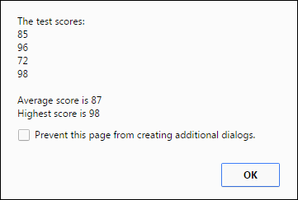
Exercise 3-2 Enhance the Test Scores app

Slide 39
Extra 3-1 Convert Fahrenheit to Celcius

Slide 40
Extra 3-2 Convert number grades to letters

Slide 41
Extra 3-2 (continued)

Slide 42
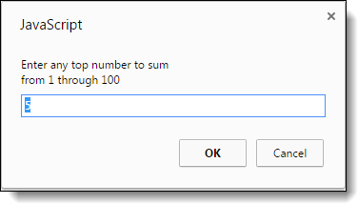
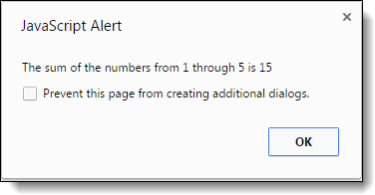
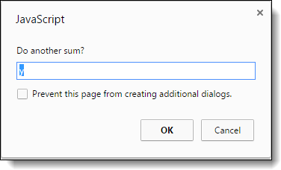
Extra 3-3 Create a sum of numbers app

Slide 43
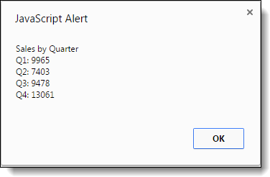
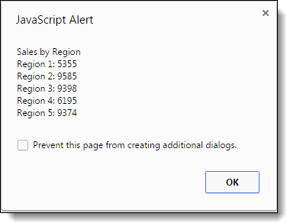
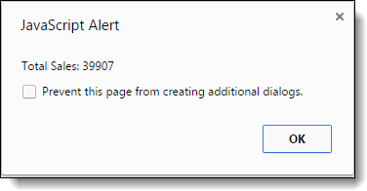
Extra 3-4 Use Sales arrays

Slide 44
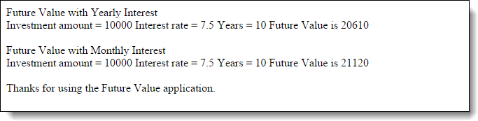
Short 3-1 Enhance the Future Value app

